Slide 1
Welcome

Slide 2
Md.Afsar Ali Amin Assistant Teacher(English) Cantt.Board Girls’ High School Rangpur Cantt. Email:www.afcharamintqi50@gmail.com

Slide 3
Black Zone
Blue zone
Red Zone
Future
Past
Bus stop
Present
Bus

Slide 4
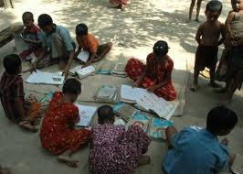
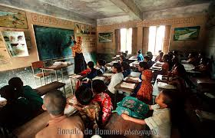
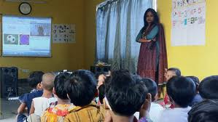
2013
2020
1990
Present
Future
past
01.What do you see here?
02.Find out the difference among the picture

Slide 5
Topics:
Tense

Slide 6
Learning Outcomes
After completing the class we will be able to
01.write sentences in different tenses
02.use the right form of verbs

Slide 7
1990
2013
2020
Tense indicates time of an action
I go to school regularly
I went to Dhaka yesterday
I shall go to Comilla tomorrow
Here the words written in red indicate time of action

Slide 8
Tense are three types
These are
Present Tense
Past Tense
Future Tense

Slide 9
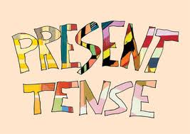

Slide 10
Present Tense
Present tense indicates an action that takes place in present time

Slide 11
Present tenses are four types and these are
Present Indefinite
Present Continuous
Present Perfect
Present perfect Continuous

Slide 12
Present Indefinite
Universal truth
Habit
Present indefinite tense means universal truth ,the action that is usual and the action that takes place regularly
Structure :Subject + present form of verb

Slide 13
Present Indefinite
Structure
eat ,ate, eaten
I eat
Subject + present form of verb

Slide 14
Keep in mind
I eat
He eats
We add s or es after the base form of verb, if the subject is third person and singular number

Slide 15
Individual work
Identify the sentence that are written in Present Indefinite
01.I like tea
02.He is a intelligent boy
03.He came to Dhaka yesterday 04. What is your food?
05. We had a cow
Answer:01,02,04

Slide 16
Assessment
He …….to school regularly(go)
I ………my work already(do)
I………..for two hours(read)
At present woman……an important role(play)
What …….your name?(be)

Slide 17
Home work
Write five sentences in Present Indefinite

Slide 18
Thank you

